Slide 1
MEDICAL IMAGE VISUALISATION AND ANALYSIS
-PUSPAMITA BANERJEE(23MM60007)
-MEGHARAJ P (23MM60004)

Slide 2
AIM
TO READ VISUALIZE AND ANALYZE MEDICAL IMAGES IN THE GIVEN DATASET.
THE DATASET CONTAINS CT AND MRI IMAGES OF VARIOUS ANATOMICAL PARTS ALONG WITH THEIR SEGMENTATION MASKS FOR THE IMAGES AS FOLLOWS:
1. ABDOMEN CT IMAGES WITH SEGMENTATION MASKS
2.HEART MRI IMAGES WITH SEGMENTATION MASKS
3.HIPPOCAMPUS MRI IMAGES WITH SEGMENTATION MASKS
4. PROSTATE MRI IMAGES WITH SEGMENTATION MASKS
THESE SCANS ARE USED FOR DIAGNOSTIC PURPOSES WHILE THE SEGMENTATION MASKS ARE USED TO IDENTIFY DIFFERENT ANATOMICAL PARTS OF THE BODY IN THE IMAGES.
ALL THE SCANS IN THE DATASET ARE 3D-VOLUMES ; EACH OF WHICH IS A STACK OF 2D-IMAGES. EACH 2D-IMAGE IS CALLED A SLICE.

Slide 3
PROBLEM STATEMENT
READ THE IMAGES.(USE NIBABEL LIBRARY TO READ THE IMAGES)
VISUALIZATION OF IMAGES. (USE MATPLOTLIB LIBRARY TO VISUALIZE THE IMAGES)
VISUALIZATION CAN BE DONE BY EITHER WAY:
VISUALIZE THE SLICES OF IMAGES AND THE SEGMENTATION MASKS
VISUALIZE THE 3D-VOLUMES OF THE IMAGES AND THE SEGMENTATION MASKS.
ANALYSIS ON THE IMAGES.(USE NUMPY LIBRARY FOR ANALYSIS OF IMAGES)
TYPE OF ANALYSIS DONE:
SIMPLE STATISTICAL ANALYSIS –
CALCULATION OF MEAN , STANDARD DEVIATION, MINIMUM AND MAXIMUM FOR THE WHOLE IMAGE AS WELL AS FOR THE SEGMENTED IMAGE.
COMPARISON OF THE STATISTICS OF THE SEGMENTED IMAGE WITH THE WHOLE IMAGE OBSERVATION.

Slide 4
MEDICAL IMAGES
CT IMAGE: IT IS A COMPUTED TOMOGRAPHY IMAGE OF CERTAIN ANATOMICAL REGION FOR THE STUDY OF A PARTICULAR ORGAN.
MRI IMAGE: IT IS A MAGNETIC RESONANCE IMAGE OF AN ANATOMICAL REGION FOR THE STUDY OF A PARTICULAR ORGAN
THE DIFFERENCE BETWEEN THESE IMAGES LIES NOT ONLY IN THEIR PRINCIPAL OF RECORDING THE IMAGE AS WELL AS THE IMAGE OUTPUT WE GET.(SOME TISSUES MAY APPEAR DARK ON CT BUT WHITE ON MRI OR VICE VERSA, Eg:FAT TISSUE, BONE)

Slide 5
SOLVING THE PROBLEM STATEMENT USING PYTHON CODE .
THE DATASET CONTAINS :
1. ABDOMEN CT IMAGES WITH SEGMENTATION MASKS
2.HEART MRI IMAGES WITH SEGMENTATION MASKS
3.HIPPOCAMPUS MRI IMAGES WITH SEGMENTATION MASKS
4. PROSTATE MRI IMAGES WITH SEGMENTATION MASKS
FOR EACH SET OF IMAGES FOR EACH ANATOMICAL PART A FUNCTION WAS CREATED WHICH PERFORMS THE FOLLOWING:
1. EACH FUNCTON READS AND PRINTS THE VISUALIZED IMAGE.
2. PRINT THE MIDDLE SLICES OF THE VISUALISATION
3.PRINT THE STACK OF THE SLICES USING NIBABEL
4.STATISTICAL ANALYSIS OF VISUALIZED IMAGE
5.STATISTICAL ANALYSIS OF SEGMENTED IMAGE
LIBRARIES IMPORTED:
OS
MATPLOTLIB
NIBABEL
NUMPY
SCIKIT
NILEARN
LIBRARIES USED:
Using os.listdir to trace the data file path in the memory
img is a list containing the compressed .gz images
Visualising the nifty image using nibabel library

Slide 6
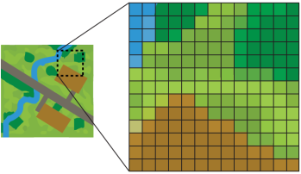
Nibabel
NIfTI (Neuroimaging Informatics Technology Initiative) is a data format for the storage of Functional Magnetic Resonance Imaging (fMRI) and other medical images.
NIfTI images are registered in a local coordinate system.
Each NIfTI file contains metadata
FME interprets NIfTI format files as follows:
1) NIfTI Reader – Reads one or more raster slices from one or more volumes in a single NIfTI file.
2)NIfTI Writer - Writes a series of raster slices into one or more volumes into a single NIfTI file.
RASTER is a rectangular matrix of evenly spaced CELLS.

Slide 7
NILEARN
package for applying statistical learning techniques
It provides tools for analysis techniques like functional connectivity, multivariate (machine-learning based) decoding, but also more basic tools like image manipulation and visualization.
NUMPY
PACKAGE IN PYTHON USED FOR SCIENTIFIC CALCULATION

Slide 8
SCIKIT
Scikit-learn is an open source data analysis library, and for Machine Learning (ML)
It is used in image segmentation, segmentation masks, assigning labels, and assigning colour to segmented images.

Slide 9
ANALYSIS OF ABDOMINAL CT
FUNCTION ANALYSYING ABDOMINAL CT IMAGES
:def abdomen_ct(): img = []
folder_dir =r"/content/drive/MyDrive/ABDOMEN CT"
for images in os.listdir(folder_dir):
# check if the image ends with .gz
if (images.endswith(".gz")):
img.append(images)
#To read the nifti file by nibabel
visulised_img=nib.load(os.path.join(folder_dir,img[3]))
print (visulised_img) # view file metadata
print(visulised_img.header)
#data is a familiar NumPy array
visulised_img_data=visulised_img.get_fdata() visulishedshape=visulised_img_data.shape

Slide 10
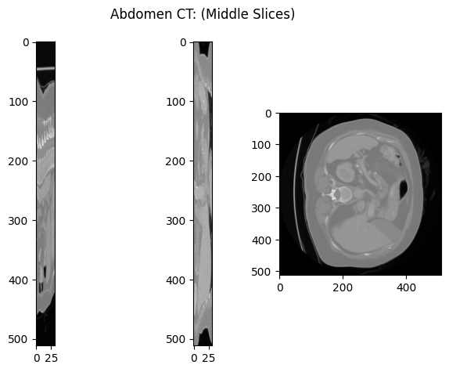
VISUALIZATION OF ABDOMINAL CT IMAGES
CODE BLOCK
VISUALIZATION OF THE IMAGE
#visualize a slice
fig, axs = plt.subplots(1,3)
fig.suptitle('Abdomen CT: (Middle Slices)')
axs[0].imshow(visulised_img_data[visulishedshape[0]//2,:,:], cmap='gray')
axs[1].imshow(visulised_img_data[:,visulishedshape[1]//2,:], cmap='gray')
axs[2].imshow(visulised_img_data[:,:,visulishedshape[2]//2], cmap='gray’)
fig.tight_layout()
plt.show()
plotting.plot_img(visulised_img)
plt.suptitle("Visulisation of Abdomen CT :by Nilearn")
plt.show()
plotting.plot_img(visulised_img, display_mode='mosaic', cmap='gray')
plt.show()
PLOTTING THE MIDDLE SLICE OF THE ABDOMINAL CT

Slide 11

VISUALISATION OF A SERIES OF SLICE IMAGES
CODE BLOCK
IMAGES
#Plot a series of slices
fig_rows = 4
fig_cols = 4
n_subplots = fig_rows * fig_cols
n_slice = visulised_img_data.shape[0]
step_size = n_slice // n_subplots
plot_range = n_subplots * step_size
start_stop = int((n_slice - plot_range) / 2)
fig, axs = plt.subplots(fig_rows, fig_cols, figsize=[10, 10])
for idx, img in enumerate(range(start_stop, plot_range, step_size)):
axs.flat[idx].imshow(ndi.rotate(visulised_img_data[:, img ,:],90), cmap='gray')
axs.flat[idx].axis('off')
fig.suptitle('Abdomen_CT:(Series of Slices)')
plt.tight_layout()
plt.show()
plotting.plot_img(visulised_img)
plt.suptitle("Visulisation of Abdomen CT :by Nilearn")
plt.show() plotting.plot_img(visulised_img, display_mode='mosaic', cmap='gray’)
plt.show()

Slide 12
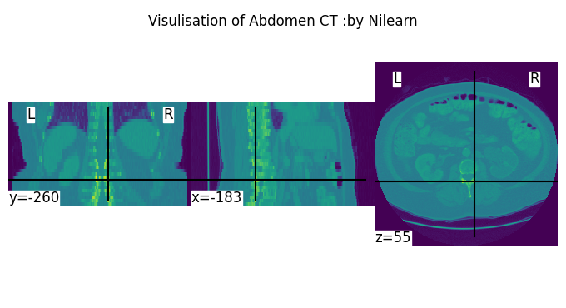
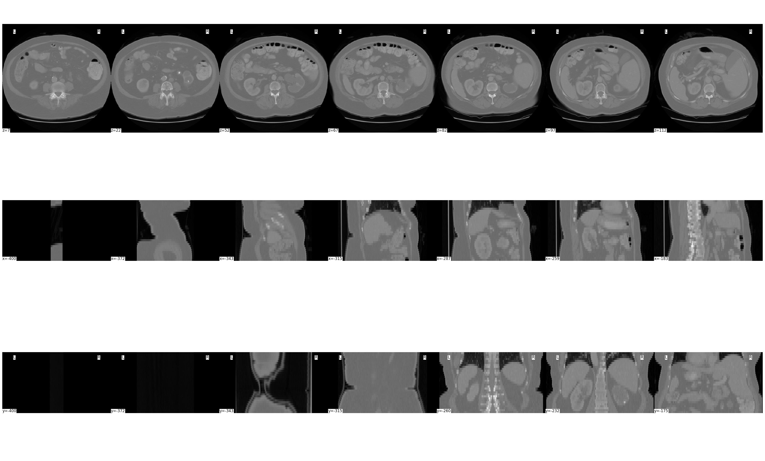
VISUALIZATION OF THE 2-D IMAGE SLICES USING NILEARN LIBRARY.

Slide 13
STATISTICAL ANALYSIS OF THE WHOLE CT
CODE BLOCK
RESULTS
#statistical analysis
print("statistical Analysis of visulised image:Abdomen_CT")
print("Mean:",visulised_img_data.mean())
print("Max:",visulised_img_data.max())
print("Min:",visulised_img_data.min())
print("standard deviation:",ny.std(visulised_img_data))
print("standard deviation:",ny.var(visulised_img_data))
statistical Analysis of visulised image:Abdomen_CT
Mean: -428.51336694532824
Max: 1166.0
Min: -1024.0
standard deviation: 485.81054320686843
standard deviation: 236011.8838909526

Slide 14
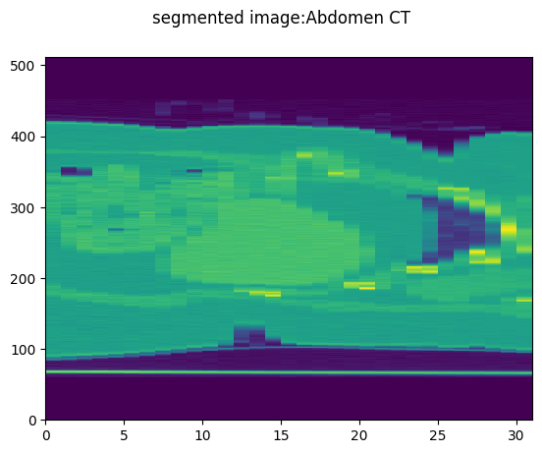
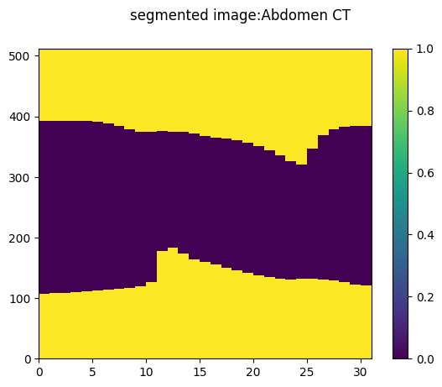
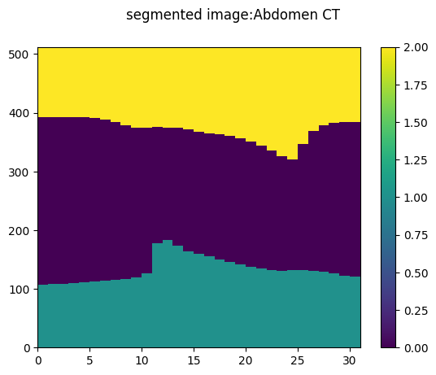
SEGMENTATION OF THE ABDOMINAL CT IMAGES
SEGMENTATION
VISUALIZATION OF SEGMENTED IMAGES
visulised_img_data.shape
fig, axs = plt.subplots(1,1)
fig.suptitle('segmented image:Abdomen CT')
plt.pcolormesh(visulised_img_data[90])
plt.colorbar
plt.show()
#segmentation of image
mask=visulised_img_data<-320
plt.suptitle('segmented image:Abdomen CT')
plt.pcolormesh(mask[50])
plt.colorbar()
plt.show()
mask_labeled=ny.vectorize(label,signature='(n,m)->(n,m)')(mask)
fig, axs = plt.subplots(1,1)
fig.suptitle('segmented image:Abdomen CT')
plt.pcolormesh(mask_labeled[50])
plt.colorbar()
plt.show()

Slide 15
STATISTICAL ANALYSIS OF SEGMENTED IMAGE
CODE BLOCK
RESULTS
#statistical analysis
print("statistical Analysis of segmented image:Abdomen_CT")
print("Mean:",visulised_img_data[90].mean())
print("Max:",visulised_img_data[90].max())
print("Min:",visulised_img_data[90].min())
print("standard deviation:",ny.std(visulised_img_data[90]))
print("standard deviation:",ny.var(visulised_img_data[90]))
statistical Analysis of segmented image:Abdomen_CT
Mean: -567.7133316532259
Max: 114.0
Min: -1024.0
standard deviation: 463.4158702005345
standard deviation: 214754.26875371864

Slide 16
CODE BLOCK FOR PLOTTING HISTOGRAM
# Original 2D array
visulised_img_data=visulised_img.get_fdata()
original_array = visulised_img_data
# Flatten using flatten method
flattened_array = original_array.flatten() # Print the original and flattened arrays
print("Original Array:")
print(original_array)
print("\nFlattened Array:")
print(flattened_array) visulised_img1_data=visulised_img.get_fdata()
original_array2 = visulised_img1_data[90]
# Flatten using flatten method
flattened_array2 = original_array2.flatten()
# Print the original and flattened arrays
print("Original Array:")
print(original_array)
print("\nFlattened Array:")
print(flattened_array)
plt.hist(flattened_array2, bins=30, color='blue', alpha=0.7)
plt.title('Histogram of Data Array')
plt.xlabel('Values')
plt.ylabel('Frequency')
plt.grid(True)
plt.show()
plt.hist(flattened_array, bins=30, color='blue', alpha=0.7)
plt.title('Histogram of Data Array')
plt.xlabel('Values')
plt.ylabel('Frequency')
plt.grid(True)
plt.show()

Slide 17
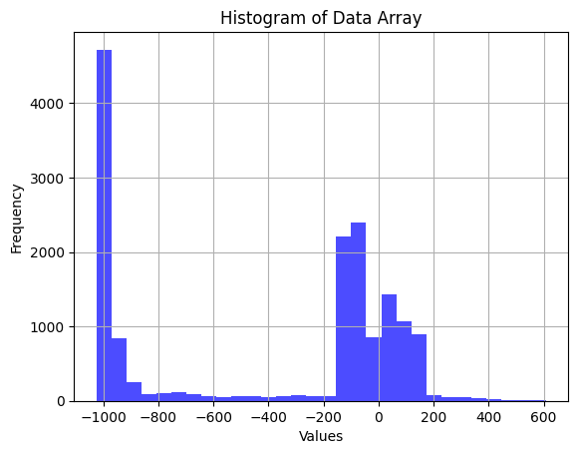
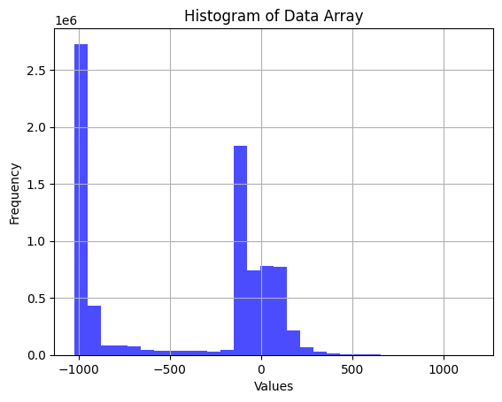
COMPARISON OF RESULTS FOR ABDOMEN CT IMAGES
HISTOGRAM FOR WHOLE IMAGE
HISTOGRAM FOR SEGMENTED IMAGE

Slide 18
ANALYSIS OF HEART MRI IMAGES
FUNCTION ANALYSYING HEART MRI IMAGES
def heart_mri():
img = []
folder_dir = r"/content/drive/MyDrive/HEART MRI"
for images in os.listdir(folder_dir):
# check if the image ends with png
if (images.endswith(".gz")):
img.append(images)
#To read the nifti file by nibabel
visulised_img=nib.load(os.path.join(folder_dir,img[3]))
print (visulised_img) # view file metadata
print(visulised_img.header)
#data is a familiar NumPy array
visulised_img_data=visulised_img.get_fdata()
visulishedshape=visulised_img_data.shape

Slide 19
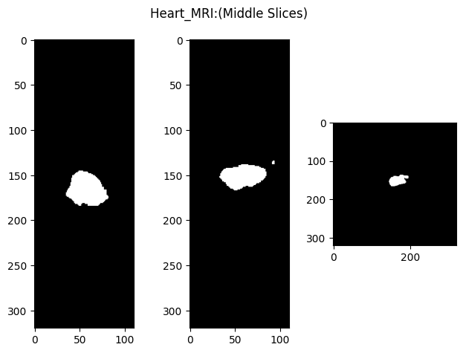
VISUALIZATION OF HEART MRI SLICE
CODE BLOCK
IMAGE
#visualize a slice
fig, axs = plt.subplots(1,3)
fig.suptitle('Heart_MRI:(Middle Slices)')
axs[0].imshow(visulised_img_data[visulishedshape[0]//2,:,:], cmap='gray')
axs[1].imshow(visulised_img_data[:,visulishedshape[1]//2,:], cmap='gray')
axs[2].imshow(visulised_img_data[:,:,visulishedshape[2]//2], cmap='gray')
fig.tight_layout()
plt.show()

Slide 20
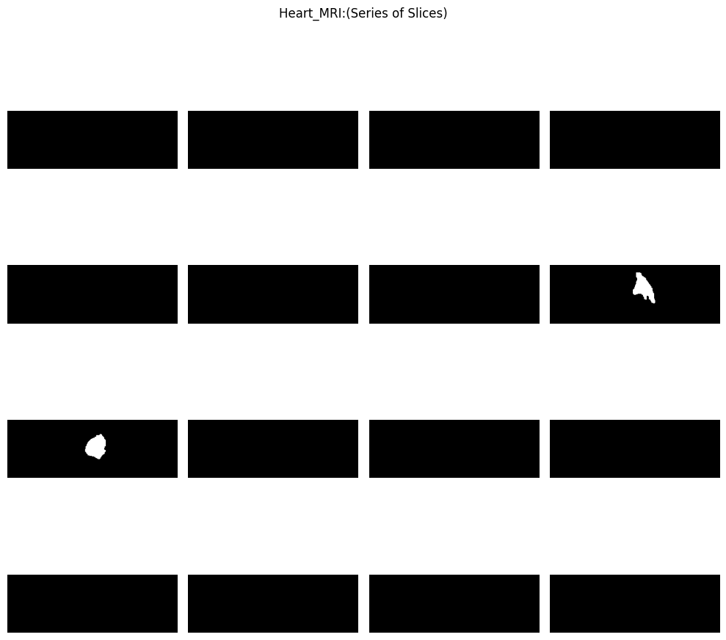
VISUALIZATION OF SERIES OF IMAGE SLICES
CODE BLOCK
IMAGES
#Plot a series of slices
fig_rows = 4
fig_cols = 4
n_subplots = fig_rows * fig_cols
n_slice = visulised_img_data.shape[0]
step_size = n_slice // n_subplots
plot_range = n_subplots * step_size
start_stop = int((n_slice - plot_range) / 2)
fig, axs = plt.subplots(fig_rows, fig_cols, figsize=[10, 10])
for idx, img in enumerate(range(start_stop, plot_range, step_size)):
axs.flat[idx].imshow(ndi.rotate(visulised_img_data[img, :, :], 90), cmap='gray')
axs.flat[idx].axis('off')
fig.suptitle('Heart_MRI:(Series of Slices)')
plt.tight_layout()
plt.show()
plotting.plot_img(visulised_img)
plt.suptitle("Visulisation of Heart_MRI :by Nilearn")
plt.show()
plotting.plot_img(visulised_img, display_mode='mosaic', cmap='gray')
plt.show()

Slide 21
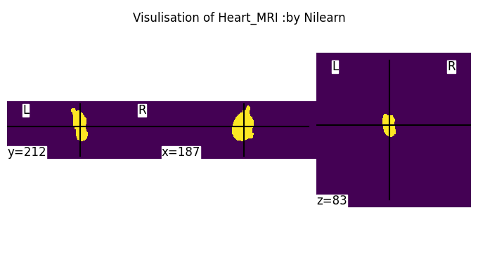

VISUALIZATION OF THE 2-D IMAGE SLICES USING NILEARN LIBRARY.
VISUALIZATION OF THE 2-D IMAGE SLICES USING NILEARN LIBRARY.

Slide 22
STATISTICAL ANALYSIS OF THE WHOLE IMAGE
RESULTS
Code block
#statistical anylysis
print("statistical Analysis of visulised image:Heart_MRI")
print("Mean:",visulised_img_data.mean())
print("Max:",visulised_img_data.max())
print("Min:",visulised_img_data.min())
print("standard deviation:",ny.std(visulised_img_data))
print("standard deviation:",ny.var(visulised_img_data))
statistical Analysis of visulised image:Heart_MRI
Mean: 0.003993430397727273
Max: 1.0
Min: 0.0
standard deviation: 0.06306728875879901
standard deviation: 0.003977482911385736

Slide 23
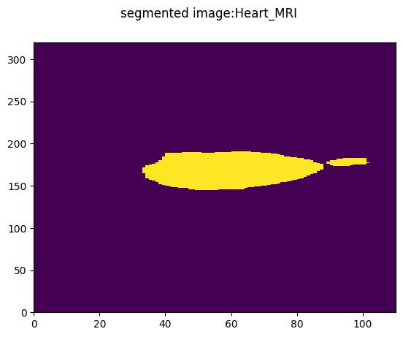
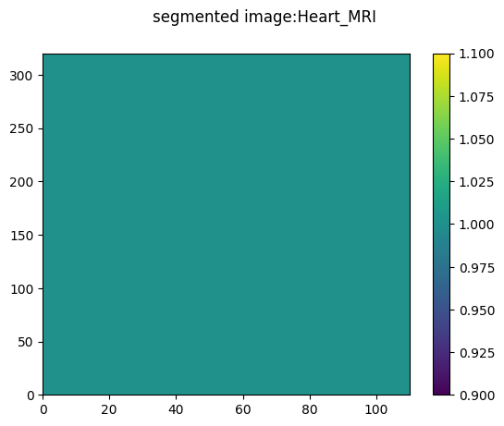

SEGMENTATION OF IMAGE
CODE BLOCK
IMAGES
#Segmentation of image
visulised_img_data.shape
fig, axs = plt.subplots(1,1)
fig.suptitle('segmented image:Heart_MRI')
plt.pcolormesh(visulised_img_data[154])
plt.colorbar
plt.show()
mask=visulised_img_data<320
plt.suptitle('segmented image:Heart_MRI')
plt.pcolormesh(mask[150])
plt.colorbar()
plt.show()
mask_labeled=ny.vectorize(label,signature='(n,m)->(n,m)')(mask)
fig, axs = plt.subplots(1,1)
fig.suptitle('segmented image:Heart_MRI')
plt.pcolormesh(mask_labeled[100])
plt.colorbar()
plt.show()

Slide 24
STATISTICAL ANALYSIS OF SEGMENTED IMAGE
CODE BLOCK
RESULTS
#statistical anylysis
print("statistical Analysis of segmented image:Heart_MRI")
print("Mean:",visulised_img_data[154].mean())
print("Max:",visulised_img_data[154].max())
print("Min:",visulised_img_data[154].min())
print("standard deviation:",ny.std(visulised_img_data[154]))
print("standard deviation:",ny.var(visulised_img_data[154]))
statistical Analysis of segmented image:Heart_MRI
Mean: 0.056875
Max: 1.0
Min: 0.0
standard deviation: 0.23160361477101346
standard deviation: 0.053640234375

Slide 25
CODE BLOCK FOR PLOTTING HISTOGRAM
# Original 2D array
visulised_img_data=visulised_img.get_fdata()
original_array = visulised_img_data
# Flatten using flatten method
flattened_array = original_array.flatten() # Print the original and flattened arrays
print("Original Array:")
print(original_array)
print("\nFlattened Array:")
print(flattened_array) visulised_img1_data=visulised_img.get_fdata()
original_array2 = visulised_img1_data[154]
# Flatten using flatten method
flattened_array2 = original_array2.flatten()
# Print the original and flattened arrays
print("Original Array:")
print(original_array)
print("\nFlattened Array:")
print(flattened_array)
plt.hist(flattened_array2, bins=30, color='blue', alpha=0.7)
plt.title('Histogram of Data Array')
plt.xlabel('Values')
plt.ylabel('Frequency')
plt.grid(True)
plt.show()
plt.hist(flattened_array, bins=30, color='blue', alpha=0.7)
plt.title('Histogram of Data Array')
plt.xlabel('Values')
plt.ylabel('Frequency')
plt.grid(True)
plt.show()

Slide 26
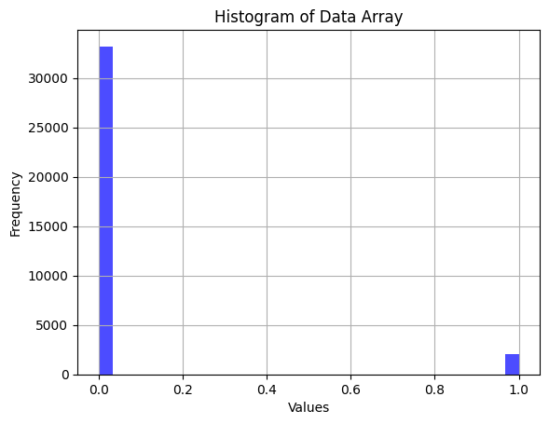
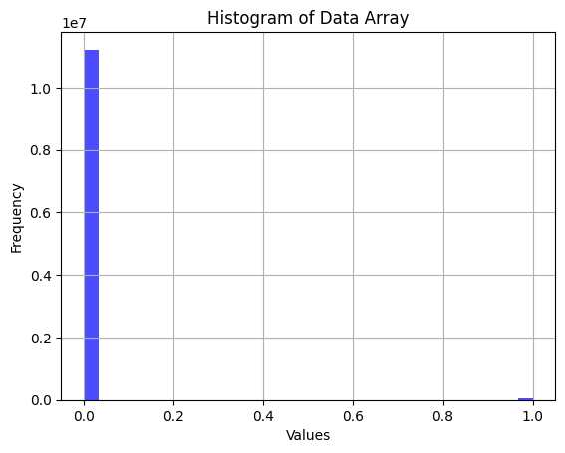
COMPARISON OF THE RESULTS FOR HEART MRI IMAGES
FOR WHOLE IMAGE
FOR SEGMENTED IMAGE

Slide 27
ANALYSIS OF HIPPOCAMPUS MRI IMAGES
FUNCTION TO ANALYSE HIPPOCAMPUS MRI IMAGES
def hippocampus_mri():
img = []
folder_dir = r"/content/drive/MyDrive/HIPPOCAMPUS MRI"
for images in os.listdir(folder_dir):
# check if the image ends with png
if (images.endswith(".gz")):
img.append(images)
visulised_img=nib.load(os.path.join(folder_dir,img[0]))
print (visulised_img)
# view file metadata
print(visulised_img.header) #data is a familiar NumPy array
visulised_img_data=visulised_img.get_fdata()
visulishedshape=visulised_img_data.shape

Slide 28
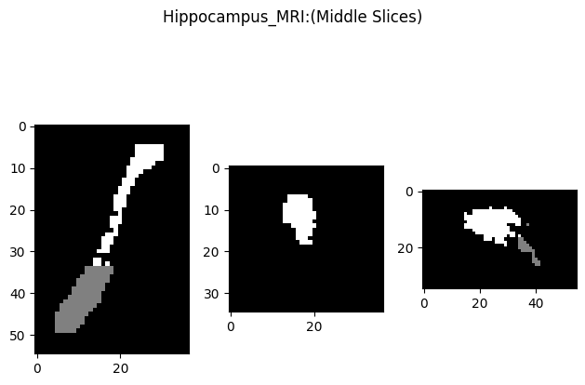
VISUALIZATION OF IMAGE SLICE
CODE BLOCK
IMAGE
#visualize a slice
fig, axs = plt.subplots(1,3)
fig.suptitle('Hippocampus_MRI:(Middle Slices)')
axs[0].imshow(visulised_img_data[visulishedshape[0]//2,:,:], cmap='gray')
axs[1].imshow(visulised_img_data[:,visulishedshape[1]//2,:], cmap='gray')
axs[2].imshow(visulised_img_data[:,:,visulishedshape[2]//2], cmap='gray')
fig.tight_layout()
plt.show()

Slide 29
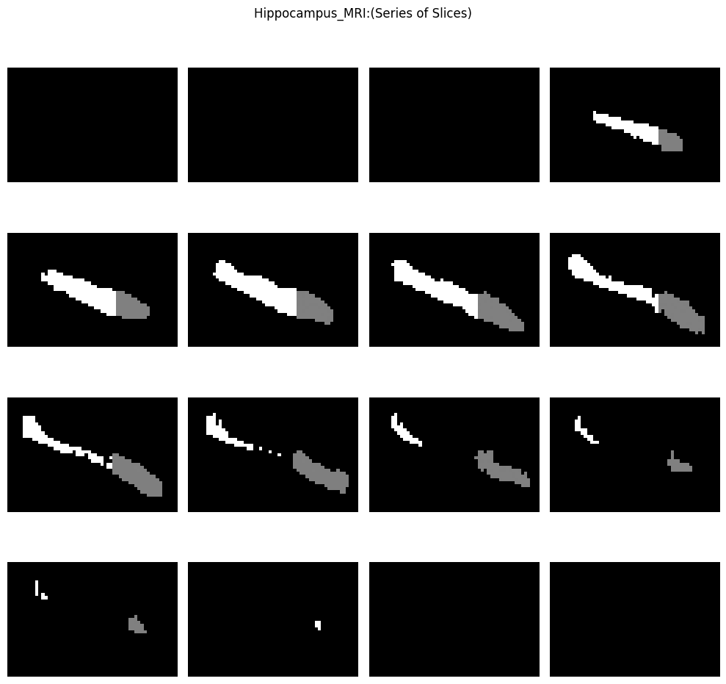
VISUALISATION OF STACKS OF SLICES
CODE BLOCK
IMAGES
#Plot a series of slices
fig_rows = 4
fig_cols = 4
n_subplots = fig_rows * fig_cols
n_slice = visulised_img_data.shape[0]
step_size = n_slice // n_subplots
plot_range = n_subplots * step_size
start_stop = int((n_slice - plot_range) / 2)
fig, axs = plt.subplots(fig_rows, fig_cols, figsize=[10, 10]) for idx, img in enumerate(range(start_stop, plot_range, step_size)):
axs.flat[idx].imshow(ndi.rotate(visulised_img_data[img, :, :], 90), cmap='gray')
axs.flat[idx].axis('off')
fig.suptitle('Hippocampus_MRI:(Series of Slices)')
plt.tight_layout()
plt.show()
plotting.plot_img(visulised_img)
plt.suptitle("Visulisation of Hippocapus_MRI :by Nilearn")
plt.show()
plotting.plot_img(visulised_img, display_mode='mosaic', cmap='gray')
plt.show()

Slide 30
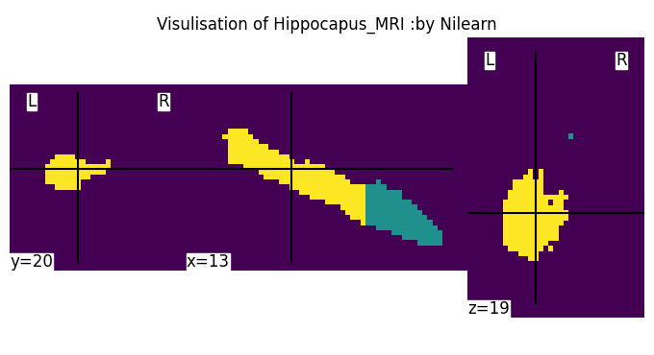
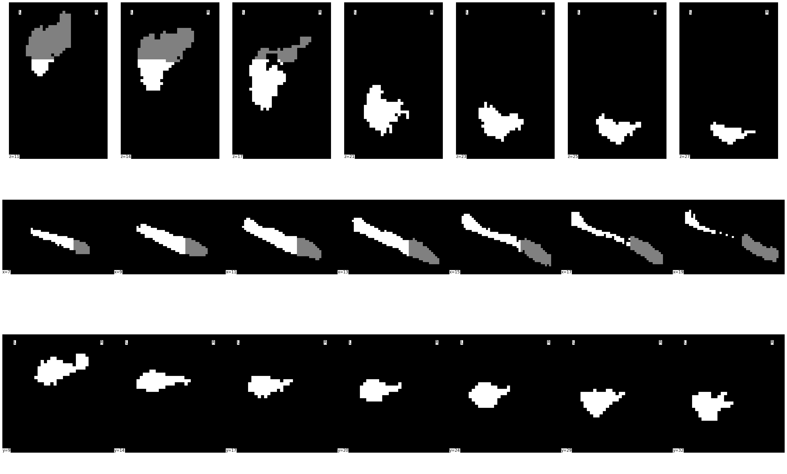
VISUALIZATION OF THE 2-D IMAGE SLICES USING NILEARN LIBRARY.

Slide 31
STATISTICAL ANALYSIS OF WHOLE IMAGE
CODE BLOCK
RESULTS
#statistical anylysis
print("statistical Analysis of visulised image:Hippocampus MRI")
print("Mean:",visulised_img_data.mean())
print("Max:",visulised_img_data.max())
print("Min:",visulised_img_data.min())
print("standard deviation:",ny.std(visulised_img_data))
print("standard deviation:",ny.var(visulised_img_data))
statistical Analysis of visulised image:Hippocampus MRI
Mean: 0.07773955773955774
Max: 2.0
Min: 0.0
standard deviation: 0.3558379600696792
standard deviation: 0.12662065382655063

Slide 32
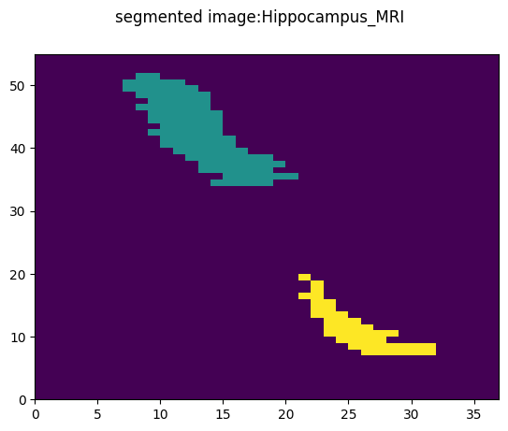
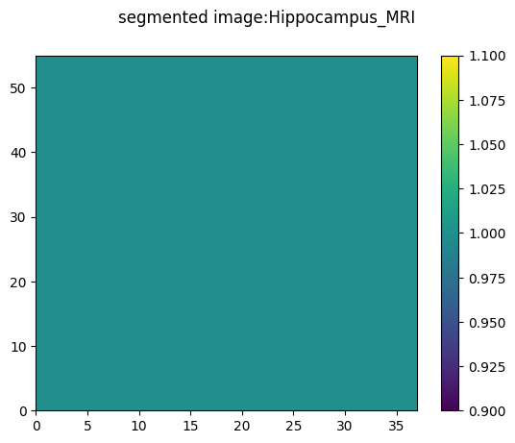

SEGMENTATION OF IMAGES
CODE BLOCK
IMAGES
#Segmentation of image
visulised_img_data.shape
fig, axs = plt.subplots(1,1)
fig.suptitle('segmented image:Hippocampus_MRI')
plt.pcolormesh(visulised_img_data[20])
plt.colorbar
plt.show()
mask=visulised_img_data<300
plt.suptitle('segmented image:Hippocampus_MRI')
plt.pcolormesh(mask[20])
plt.colorbar()
plt.show()
mask_labeled=ny.vectorize(label,signature='(n,m)->(n,m)')(mask)
fig, axs = plt.subplots(1,1)
fig.suptitle('segmented image:Hippocampus_MRI')
plt.pcolormesh(mask_labeled[30])
plt.colorbar()
plt.show()

Slide 33
STATISTICAL ANALYSIS OF SEGMENTED IMAGE
CODE BLOCK
RESULTS
#statistical anylysis
print("statistical Analysis of segmented image:Hippocampus MRI")
print("Mean:",visulised_img_data[20].mean())
print("Max:",visulised_img_data[20].max())
print("Min:",visulised_img_data[20].min())
print("standard deviation:",ny.std(visulised_img_data[20]))
print("standard deviation:",ny.var(visulised_img_data[20]))
statistical Analysis of segmented image:Hippocampus MRI
Mean: 0.0914004914004914
Max: 2.0
Min: 0.0
standard deviation: 0.35259620368047273
standard deviation: 0.1243240828498814

Slide 34
CODE BLOCK FOR PLOTTING HISTOGRAM
# Original 2D array
visulised_img_data=visulised_img.get_fdata()
original_array = visulised_img_data
# Flatten using flatten method
flattened_array = original_array.flatten() # Print the original and flattened arrays
print("Original Array:")
print(original_array)
print("\nFlattened Array:")
print(flattened_array) visulised_img1_data=visulised_img.get_fdata()
original_array2 = visulised_img1_data[20]
# Flatten using flatten method
flattened_array2 = original_array2.flatten()
# Print the original and flattened arrays
print("Original Array:")
print(original_array)
print("\nFlattened Array:")
print(flattened_array)
plt.hist(flattened_array2, bins=30, color='blue', alpha=0.7)
plt.title('Histogram of Data Array')
plt.xlabel('Values')
plt.ylabel('Frequency')
plt.grid(True)
plt.show()
plt.hist(flattened_array, bins=30, color='blue', alpha=0.7)
plt.title('Histogram of Data Array')
plt.xlabel('Values')
plt.ylabel('Frequency')
plt.grid(True)
plt.show()

Slide 35
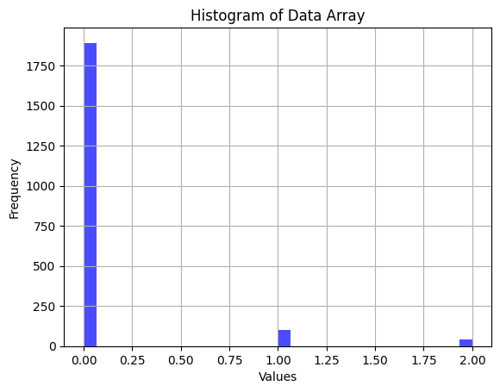
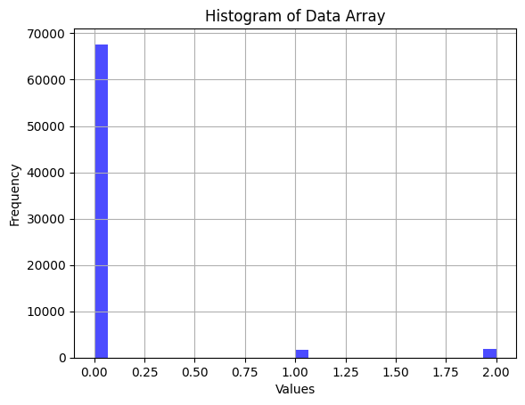
COMPARISON OF THE RESULTS FOR HIPPOCAMPUS MRI IMAGES
FOR WHOLE IMAGE
FOR SEGMENTED IMAGE

Slide 36
ANALYSIS OF PROSTATE MRI IMAGES(FOLDER-1/157)
FUNCTION ANALYSYING PROSTATE MRI IMAGES
def prostate_mri157():
img = []
folder_dir = r"/content/drive/MyDrive/PROSTRATE MRI/New folder1"
for images in os.listdir(folder_dir):
# check if the image ends with png
if (images.endswith(".gz")):
img.append(images)
visulised_img=nib.load(os.path.join(folder_dir,img[0]))
print (visulised_img)
# view file metadata
print(visulised_img.header)
#data is a familiar NumPy array
visulised_img_data=visulised_img.get_fdata()
visulishedshape=visulised_img_data.shape

Slide 37
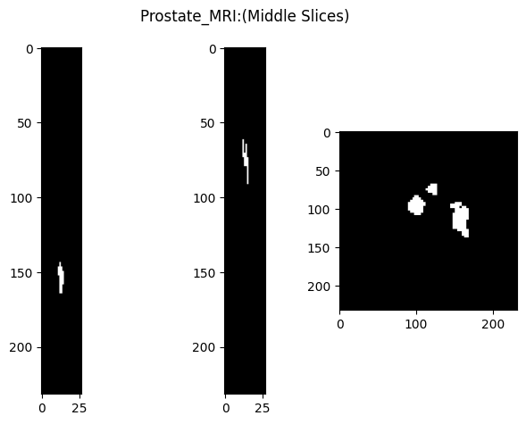
VISUALIZATION OF IMAGE SLICE
CODE BLOCK
IMAGE:
#visualize a slice
fig, axs = plt.subplots(1,3)
fig.suptitle('Prostate_MRI:(Middle Slices)')
axs[0].imshow(visulised_img_data[visulishedshape[0]//2,:,:], cmap='gray')
axs[1].imshow(visulised_img_data[:,visulishedshape[1]//2,:], cmap='gray')
axs[2].imshow(visulised_img_data[:,:,visulishedshape[2]//2], cmap='gray')
fig.tight_layout()
plt.show()

Slide 38

VISUALISATION OF A SERIES OF IMAGE SLICES
CODE BLOCK
IMAGE:
#Plot a series of slices
fig_rows = 4
fig_cols = 4
n_subplots = fig_rows * fig_cols
n_slice = visulised_img_data.shape[0]
step_size = n_slice // n_subplots
plot_range = n_subplots * step_size
start_stop = int((n_slice - plot_range) / 2)
fig, axs = plt.subplots(fig_rows, fig_cols, figsize=[10, 10])
for idx, img in enumerate(range(start_stop, plot_range, step_size)):
axs.flat[idx].imshow(ndi.rotate(visulised_img_data[img, :, :], 90), cmap='gray')
axs.flat[idx].axis('off')
fig.suptitle('Prostatr_MRI:(Series of Slices)')
plt.tight_layout()
plt.show()
plotting.plot_img(visulised_img)
plt.suptitle("Visulisation of Prostate_MRI :by Nilearn")
plt.show()
plotting.plot_img(visulised_img, display_mode='mosaic', cmap='gray')
plt.show()

Slide 39
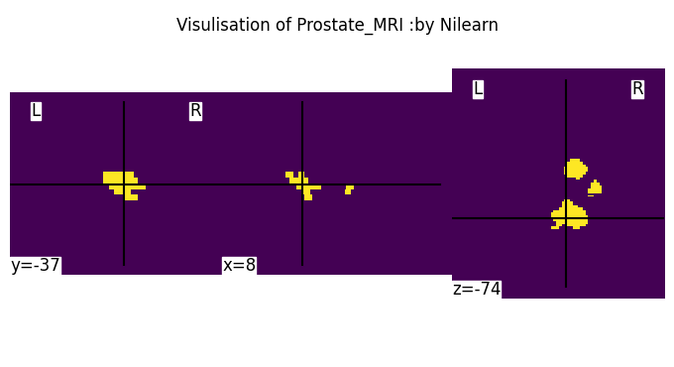

VISUALIZATION OF THE 2-D IMAGE SLICES USING NILEARN LIBRARY.

Slide 40
STATISTICAL ANALYSIS OF THE WHOLE IMAGE
CODE BLOCK
RESULTS
#statistical anylysis
print("statistical Analysis of visulised image:Prostate MRI")
print("Mean:",visulised_img_data.mean())
print("Max:",visulised_img_data.max())
print("Min:",visulised_img_data.min())
print("standard deviation:",ny.std(visulised_img_data))
print("standard deviation:",ny.var(visulised_img_data))
statistical Analysis of visulised image:Prostate MRI
Mean: 0.003199729158409301
Max: 1.0
Min: 0.0
standard deviation: 0.056475577834336044
standard deviation: 0.0031894908917221485

Slide 41
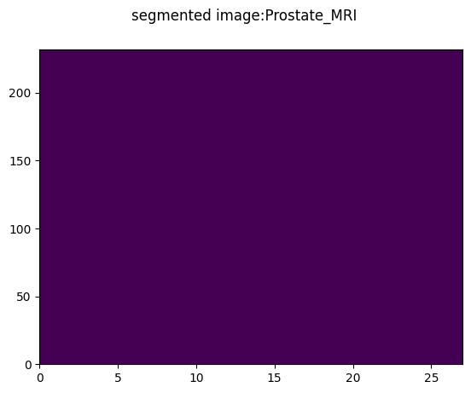


SEGMENTATION OF IMAGE
CODE BLOCK
SEGMENTED IMAGE:
#segmentation of image
visulised_img_data.shape
fig, axs = plt.subplots(1,1)
fig.suptitle('segmented image:Prostate_MRI')
plt.pcolormesh(visulised_img_data[150])
plt.colorbar
plt.show()
mask=visulised_img_data<320
plt.suptitle('segmented image:Prostate_MRI')
plt.pcolormesh(mask[100])
plt.colorbar()
plt.show()
mask_labeled=ny.vectorize(label,signature='(n,m)->(n,m)')(mask)
fig, axs = plt.subplots(1,1)
fig.suptitle('segmented image:Prostate_MRI')
plt.pcolormesh(mask_labeled[100])
plt.colorbar()
plt.show()

Slide 42
STATISTICAL ANALYSIS OF SEGMENTED IMAGE
CODE BLOCK
RESULTS:
#statistical anylysis
print("statistical Analysis of segmented image:Prostate MRI")
print("Mean:",visulised_img_data[100].mean())
print("Max:",visulised_img_data[100].max())
print("Min:",visulised_img_data.min())
print("standard deviation:",ny.std(visulised_img_data[100]))
print("standard deviation:",ny.var(visulised_img_data[100]))
statistical Analysis of visulised image:Prostate MRI
Mean: 0.021711366538952746
Max: 1.0
Min: 0.0
standard deviation: 0.14573943564445413
standard deviation: 0.021239983101963986

Slide 43
CODE BLOCK FOR PLOTTING HISTOGRAM
# Original 2D array
visulised_img_data=visulised_img.get_fdata()
original_array = visulised_img_data
# Flatten using flatten method
flattened_array = original_array.flatten() # Print the original and flattened arrays
print("Original Array:")
print(original_array)
print("\nFlattened Array:")
print(flattened_array) visulised_img1_data=visulised_img.get_fdata()
original_array2 = visulised_img1_data[100]
# Flatten using flatten method
flattened_array2 = original_array2.flatten()
# Print the original and flattened arrays
print("Original Array:")
print(original_array)
print("\nFlattened Array:")
print(flattened_array)
plt.hist(flattened_array2, bins=30, color='blue', alpha=0.7)
plt.title('Histogram of Data Array')
plt.xlabel('Values')
plt.ylabel('Frequency')
plt.grid(True)
plt.show()
plt.hist(flattened_array, bins=30, color='blue', alpha=0.7)
plt.title('Histogram of Data Array')
plt.xlabel('Values')
plt.ylabel('Frequency')
plt.grid(True)
plt.show()

Slide 44
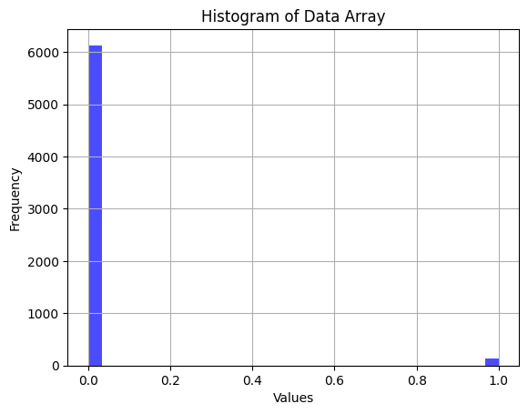
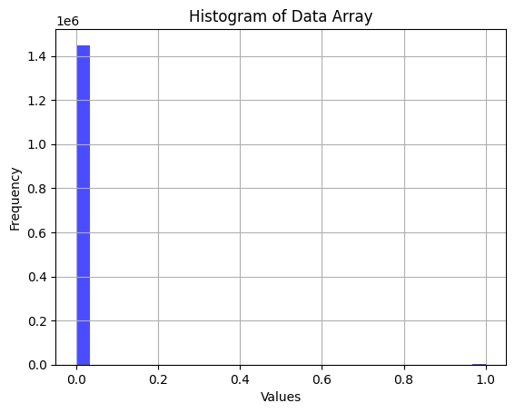
COMPARISON OF THE RESULTS FOR PROSTATE MRI IMAGES
FOR WHOLE IMAGE
FOR SEGMENTED IMAGE

Slide 45
ANALYSIS OF PROSTATE MRI IMAGES(FOLDER-2/158)
FUNCTION ANALYSYING PROSTATE MRI IMAGES
def prostate_mri158():
img = []
folder_dir = r"/content/drive/MyDrive/PROSTRATE MRI/New folder2"
for images in os.listdir(folder_dir):
# check if the image ends with png
if (images.endswith(".gz")):
img.append(images)
#To read the nifti file by nibabel
visulised_img=nib.load(os.path.join(folder_dir,img[0]))
print (visulised_img)
# view file metadata
print(visulised_img.header)
#data is a familiar NumPy array
visulised_img_data=visulised_img.get_fdata()
visulishedshape=visulised_img_data.shape

Slide 46
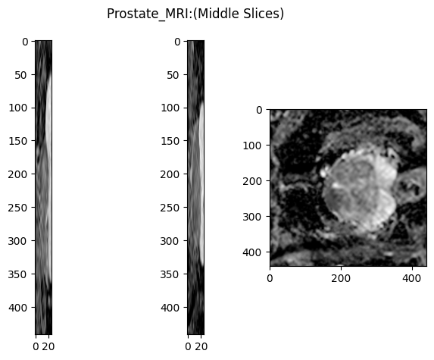
VISUALIZATION OF IMAGE SLICE
CODE BLOCK
IMAGE
#visualize a slice
fig, axs = plt.subplots(1,3)
fig.suptitle('Prostate_MRI:(Middle Slices)')
axs[0].imshow(visulised_img_data[visulishedshape[0]//2,:,:], cmap='gray')
axs[1].imshow(visulised_img_data[:,visulishedshape[1]//2,:], cmap='gray')
axs[2].imshow(visulised_img_data[:,:,visulishedshape[2]//2], cmap='gray')
fig.tight_layout()
plt.show()

Slide 47

VISUALIZATION OF A SERIES OF IMAGE SLICES
CODE BLOCK
IMAGE
#Plot a series of slices
fig_rows = 4
fig_cols = 4
n_subplots = fig_rows * fig_cols
n_slice = visulised_img_data.shape[0]
step_size = n_slice // n_subplots
plot_range = n_subplots * step_size
start_stop = int((n_slice - plot_range) / 2)
fig, axs = plt.subplots(fig_rows, fig_cols, figsize=[10, 10])
for idx, img in enumerate(range(start_stop, plot_range, step_size)):
axs.flat[idx].imshow(ndi.rotate(visulised_img_data[:, img, :], 90), cmap='gray')
axs.flat[idx].axis('off')
fig.suptitle('Prostate_MRI:(Series of Slices)')
plt.tight_layout()
plt.show()
plotting.plot_img(visulised_img)
plt.suptitle("Visulisation of Prostate_MRI :by Nilearn")
plt.show()
plotting.plot_img(visulised_img, display_mode='mosaic', cmap='gray')
plt.show()

Slide 48
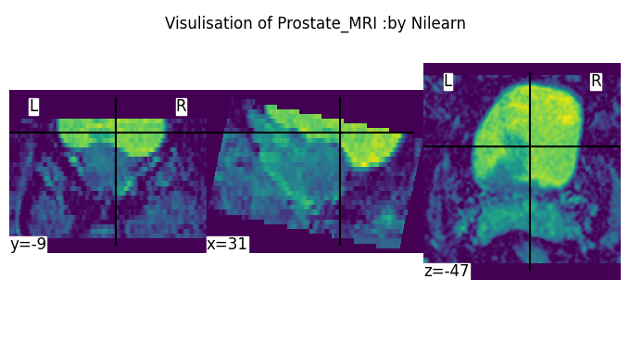
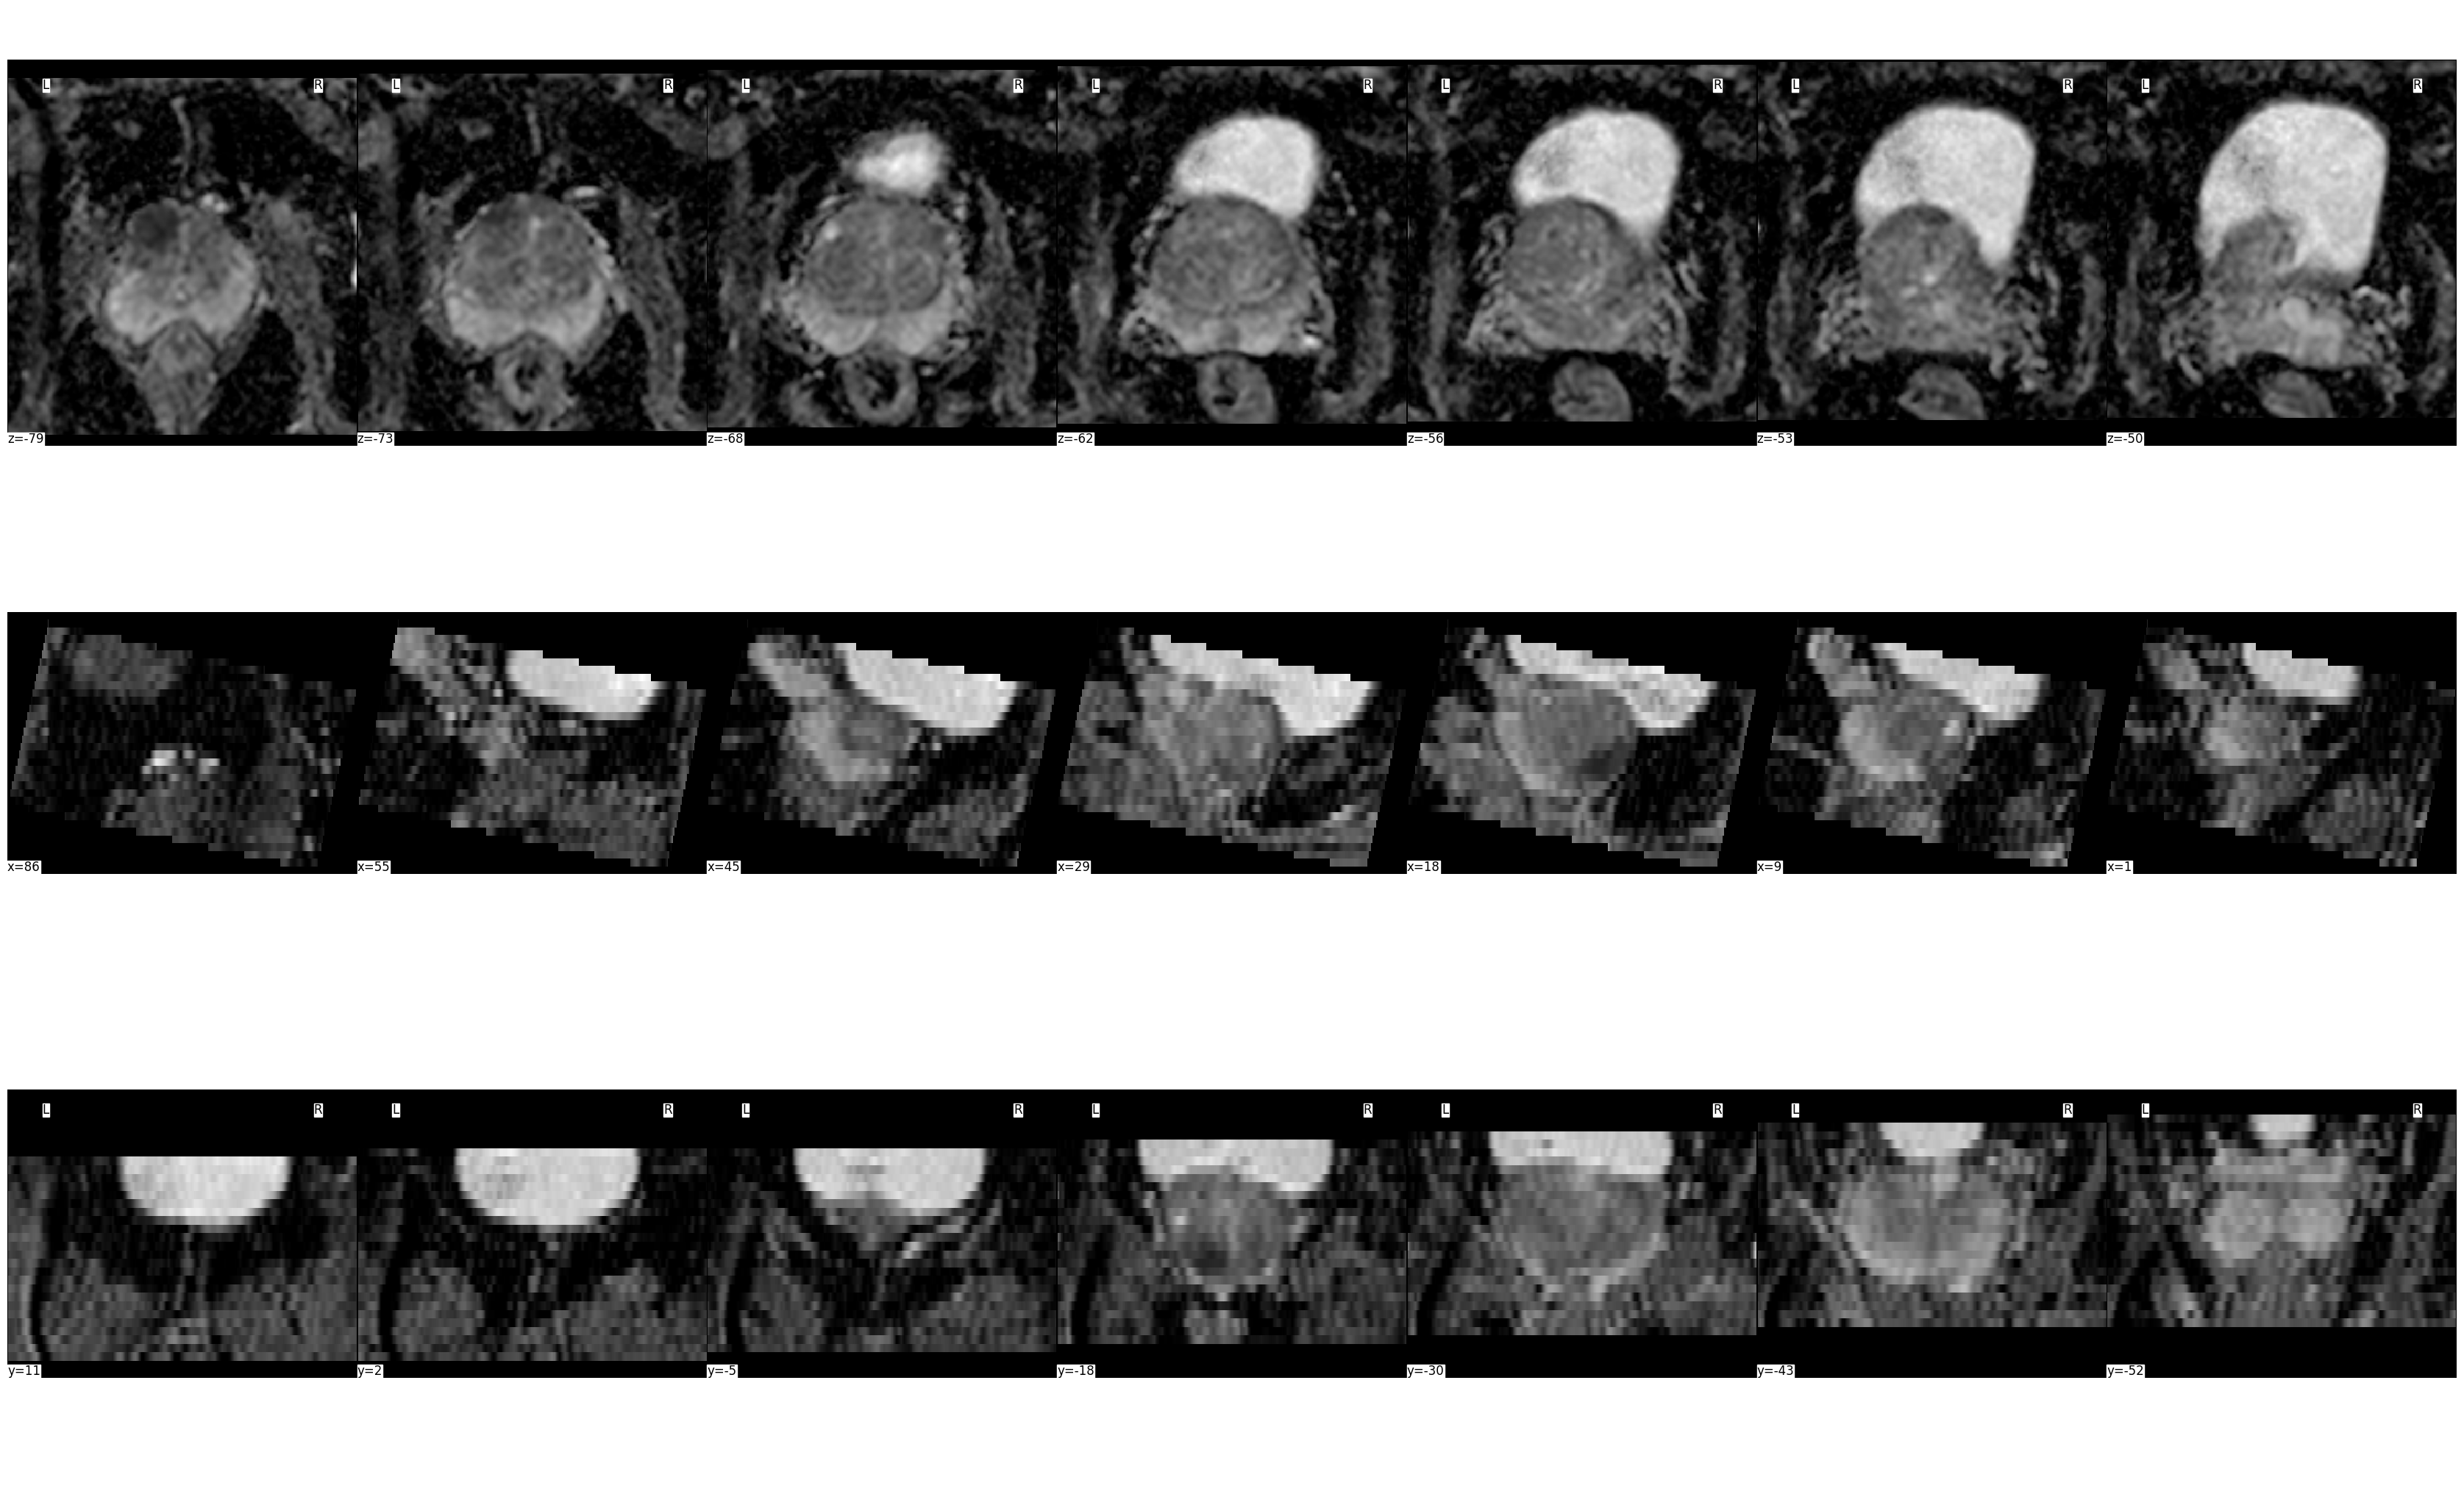
VISUALIZATION OF THE 2-D IMAGE SLICES USING NILEARN LIBRARY.

Slide 49
STATISTICAL ANALYSIS OF THE WHOLE IMAGE
CODE BLOCK
RESULTS
#statistical anylysis
print("statistical Analysis of visulised image:Prostate MRI")
print("Mean:",visulised_img_data.mean())
print("Max:",visulised_img_data.max())
print("Min:",visulised_img_data.min())
print("standard deviation:",ny.std(visulised_img_data))
print("standard deviation:",ny.var(visulised_img_data))
statistical Analysis of visulised image:Prostate MRI
Mean: 817.8060509288981
Max: 3607.068359375
Min: 0.0
standard deviation: 745.8661382826112
standard deviation: 556316.2962366153

Slide 50
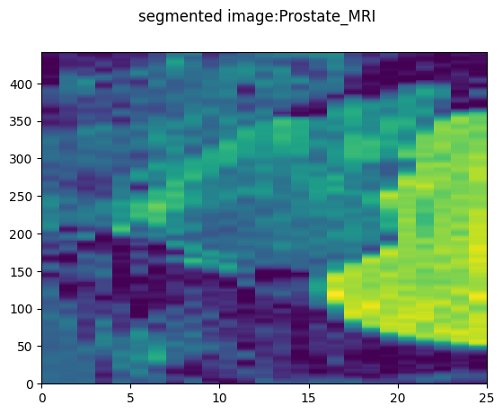
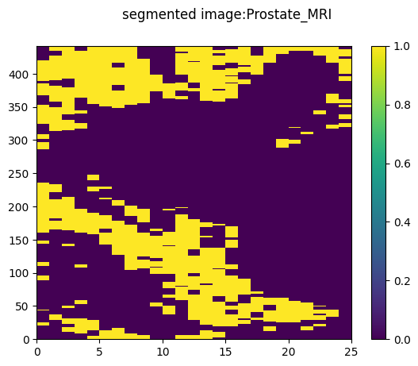
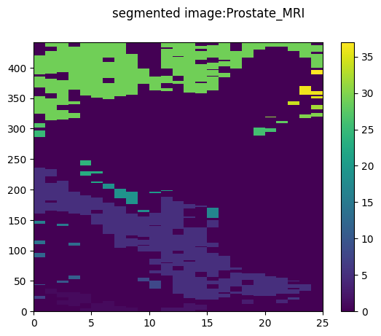
SEGMENTATION OF IMAGE
CODE BLOCK
IMAGE
#Segmentation of image
visulised_img_data.shape
fig, axs = plt.subplots(1,1)
fig.suptitle('segmented image:Prostate_MRI')
plt.pcolormesh(visulised_img_data[200])
plt.colorbar
plt.show()
mask=visulised_img_data<320
plt.suptitle('segmented image:Prostate_MRI')
plt.pcolormesh(mask[150])
plt.colorbar()
plt.show()
mask_labeled=ny.vectorize(label,signature='(n,m)->(n,m)')(mask)
fig, axs = plt.subplots(1,1)
plt.suptitle('segmented image:Prostate_MRI')
plt.pcolormesh(mask_labeled[150])
plt.colorbar()
plt.show()

Slide 51
STATISTICAL ANALYSIS OF SEGMENTED IMAGE
CODE BLOCK
RESULTS
#statistical anylysis
print("statistical Analysis of segmented image:Prostate MRI")
print("Mean:",visulised_img_data[200].mean())
print("Max:",visulised_img_data[200].max())
print("Min:",visulised_img_data[200].min())
print("standard deviation:",ny.std(visulised_img_data[200]))
print("standard deviation:",ny.var(visulised_img_data[200]))
statistical Analysis of segmented image:Prostate MRI
Mean: 1327.3683105965179
Max: 3415.42626953125
Min: 0.0
standard deviation: 863.6383321146188
standard deviation: 745871.1686977207

Slide 52
CODE BLOCK FOR PLOTTING HISTOGRAM
# Original 2D array
visulised_img_data=visulised_img.get_fdata()
original_array = visulised_img_data
# Flatten using flatten method
flattened_array = original_array.flatten() # Print the original and flattened arrays
print("Original Array:")
print(original_array)
print("\nFlattened Array:")
print(flattened_array) visulised_img1_data=visulised_img.get_fdata()
original_array2 = visulised_img1_data[200]
# Flatten using flatten method
flattened_array2 = original_array2.flatten()
# Print the original and flattened arrays
print("Original Array:")
print(original_array)
print("\nFlattened Array:")
print(flattened_array)
plt.hist(flattened_array2, bins=30, color='blue', alpha=0.7)
plt.title('Histogram of Data Array')
plt.xlabel('Values')
plt.ylabel('Frequency')
plt.grid(True)
plt.show()
plt.hist(flattened_array, bins=30, color='blue', alpha=0.7)
plt.title('Histogram of Data Array')
plt.xlabel('Values')
plt.ylabel('Frequency')
plt.grid(True)
plt.show()

Slide 53
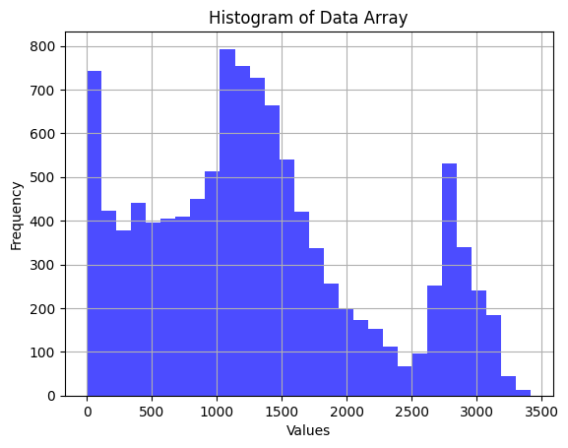
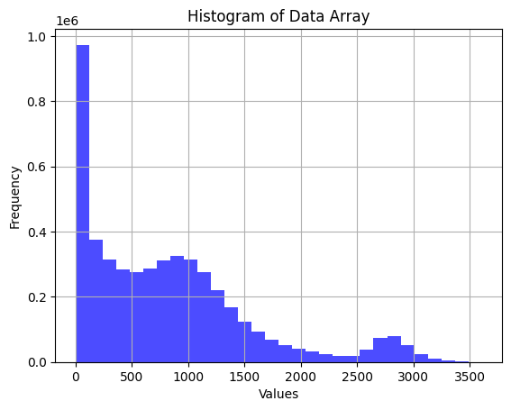
COMPARISON OF THE RESULTS FOR PROSTATE MRI IMAGES
FOR WHOLE IMAGE
FOR SEGMENTED IMAGE

Slide 54
COMPARISON OF THE STATISTICAL ANALYSIS VALUES OF THE WHOLE VISUALISED IMAGE AND THE SEGMENTED IMAGE IN EACH CASES:
 | STATISTICAL ANALYSIS OF WHOLE IMAGE | STATISTICAL ANALYSIS OF SEGMENTED IMAGE
ABDOMEN CT IMAGES | Mean: -428.51336694532824 Max: 1166.0 Min: -1024.0 standard deviation: 485.81054320686843 standard deviation: 236011.8838909526 | Mean: -567.7133316532259 Max: 114.0 Min: -1024.0 standard deviation: 463.4158702005345 standard deviation: 214754.26875371864
HEART MRI IMAGES | Mean: 0.003993430397727273 Max: 1.0 Min: 0.0 standard deviation: 0.06306728875879901 standard deviation:0.003977482911385736 | Mean: 0.056875 Max: 1.0 Min: 0.0 standard deviation: 0.23160361477101346 standard deviation: 0.053640234375
HIPPOCAMPUS MRI IMAGES | Mean: 0.07773955773955774 Max: 2.0 Min: 0.0 standard deviation: 0.3558379600696792 standard deviation: 0.12662065382655063 | Mean: 0.0914004914004914 Max: 2.0 Min: 0.0 standard deviation: 0.35259620368047273 standard deviation: 0.1243240828498814
PROSTATE MRI IMAGES (FOLDER-1/157) | Mean: 0.003199729158409301 Max: 1.0 Min: 0.0 standard deviation: 0.056475577834336044 standard deviation:0.0031894908917221485 | Mean: 0.021711366538952746 Max: 1.0 Min: 0.0 standard deviation: 0.14573943564445413 standard deviation: 0.021239983101963986
PROSTATE MRI IMAGES (FOLDER-2/158) | Mean: 817.8060509288981 Max: 3607.068359375 Min: 0.0 standard deviation: 745.8661382826112 standard deviation: 556316.2962366153 | Mean: 1327.3683105965179 Max: 3415.42626953125 Min: 0.0 standard deviation: 863.6383321146188 standard deviation: 745871.1686977207

Slide 55
INTERPRETATION OF COMPARISON RESULTS
 | STATISTICAL INTERPRETATION FROM THE PREVIOUS TABLE
ABDOMINAL CT | PIXEL INTENSITY MEAN VALUES HAVE SLIGHTLY DECREASED WITH SIGNIFICANT DECREASE IN VARIANCE IN THE SEGMENTED IMAGE .
HEART MRI | PIXEL INTENSITY VALUES : MEAN HAS INCREASED WITH SIGNIFICANT INCREASE IN VARIANCE IN THE SEGMENTED IMAGE.
HIPPOCAMPUS MRI | PIXEL INTENSITY VALUES : MEAN HAS INCREASED WITH NO CHANGE IN VARIANCE IN THE SEGMENTED IMAGE.
PROSTATE MRI IMAGES (FOLDER-1/157) | PIXEL INTENSITY VALUES : MEAN HAS INCREASED WITH SIGNIFICANT INCREASE IN VARIANCE IN THE SEGMENTED IMAGE.
PROSTATE MRI IMAGES (FOLDER-2/158) | PIXEL INTENSITY VALUES : MEAN HAS INCREASED WITH SIGNIFICANT INCREASE IN VARIANCE IN THE SEGMENTED IMAGE.

Slide 56
RESOURCES
Neuroimaging in Python — NiBabel 5.1.0 documentation (nipy.org)
Specific images — skimage 0.22.0 documentation (scikit-image.org)
Matplotlib — Visualization with Python
NumPy
ummadiviany/pds_final_projects at b6e3b9807845dc278498d3f027724601e53d12e7 (github.com)

Slide 57
THANK YOU

